Slide 1

Introduction to Python

Slide 2
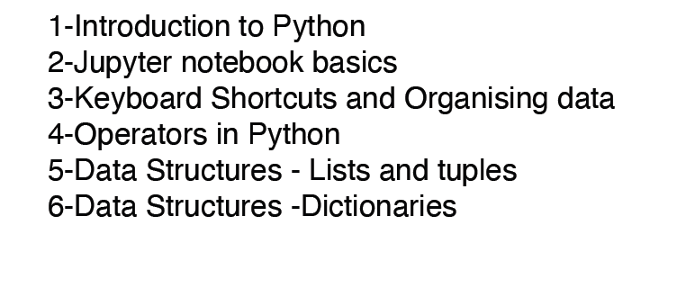
Course

Slide 3
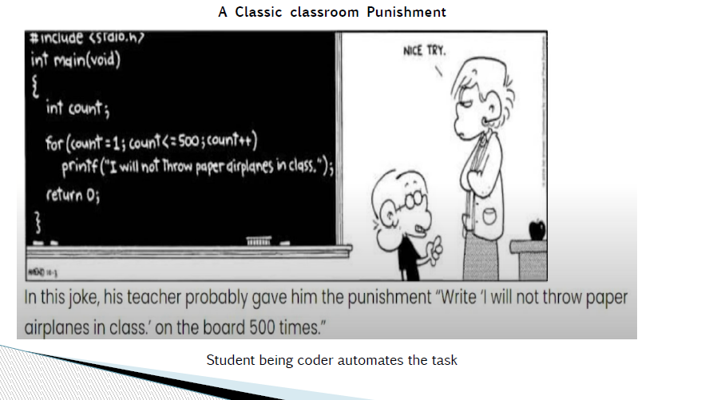

Slide 4
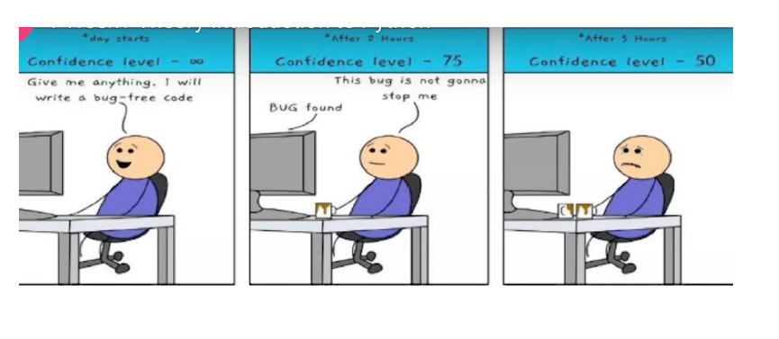

Slide 5
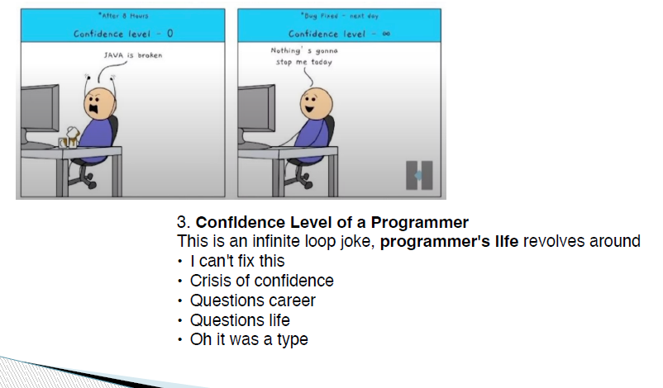

Slide 6
What is key takeaway for Python Learners???
Bugs are part of journey. Your confidence might fluctuate, but every challenge strengthens your problem solving skills.

Slide 7
In this lecture
Introduction to Python
History of Python
Features of Python
Python IDEs

Slide 8
Introduction
We live in a world that’s drowning in data
Data is generated from various sources
  Websites track every user’s every click
  Your smartphone is building up a record of your location
  Sensors from electronic devices record real time information
  E-commerce websites collect purchasing habits

Slide 9
Popular tools used
Data pre-processing, exploration, visualization and analysis
  Python

Slide 10
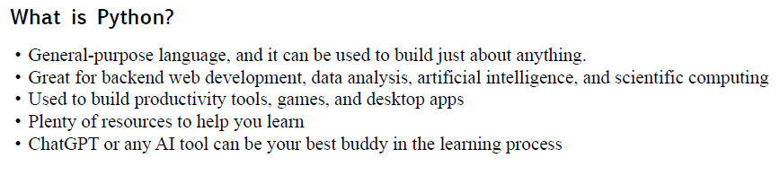
Python

Slide 11

Python Overview
Python is a high-level, interpreted, interactive and object oriented-scripting language.
Python was designed to be highly readable which uses English keywords frequently where as other languages use punctuation and it has fewer syntactical constructions than other languages.

Slide 12

Evolution of Python
Python was developed by Guido van Rossum in the late eighties at the ‘National Research Institute for Mathematics and Computer Science’ at Netherlands
Guido van Rossum is a Dutch programmer best known as the author of the Python programming language, for which he was the "Benevolent Dictator For Life"
Created python language in late 1980’s during Christmas holidays as a hobby project and little did he know that it would go on to become one of the most popular programming language in the world.

Slide 13
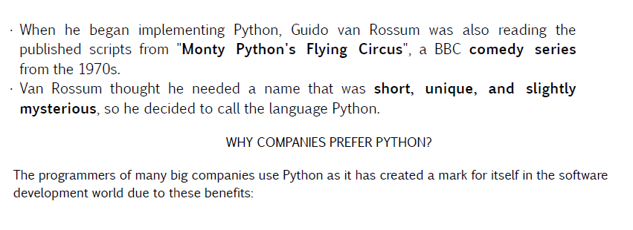
Where does the Python name come from?

Slide 14
Brief History of Python
Invented in the Netherlands, early 90s by Guido van Rossum
Named after Monty Python
Open sourced from the beginning
Considered a scripting language, but is much more
Used by Google from the beginning
Increasingly popular
Python Editions
  Python 1.0-1991,
  Python 2.0- 2000
  Python 3.0 - 2008 (Python 3.13 latest)

Slide 15
Benefits of using PYTHON
•Easy-to-learn
•Easy-to-read
•Easy-to-maintain (to update over time)
•Robust (can handle big tasks)
•Case Sensitive Language
• Effective as a Rapid Prototyping Tool
•A Memory Manager
• Interpreted and (Byte-) Compiled language
(does not require fully compilation)
Challenges in using PYTHON
• Python is evolving continuously.
•Not a great choice for a high-graphic 3d games
(C++ performs better)
•Memory Consumption.
•Database Access is not the fastest.
•Runtime Errors
(typo errors can pop up at run-time).

Slide 16
Advantages of using python
Python has several features that make it well suited for data science
Syntax used is simple to understand and code
Open source and community development
  Developed under Open Source Initiative approved license making it free to use and distribute even commercially
Libraries designed for specific data science tasks
Combines well with majority of the cloud platform service providers

Slide 17
Python
Big companies like Google, NASA, Netflix, Instagram, and Spotify use Python for various tasks because it is versatile and reliable.
You can install Python from python.org or use online platforms such as Google Colab. There are other IDEs such as VS Code, or PyCharm to write Python code.

Slide 18
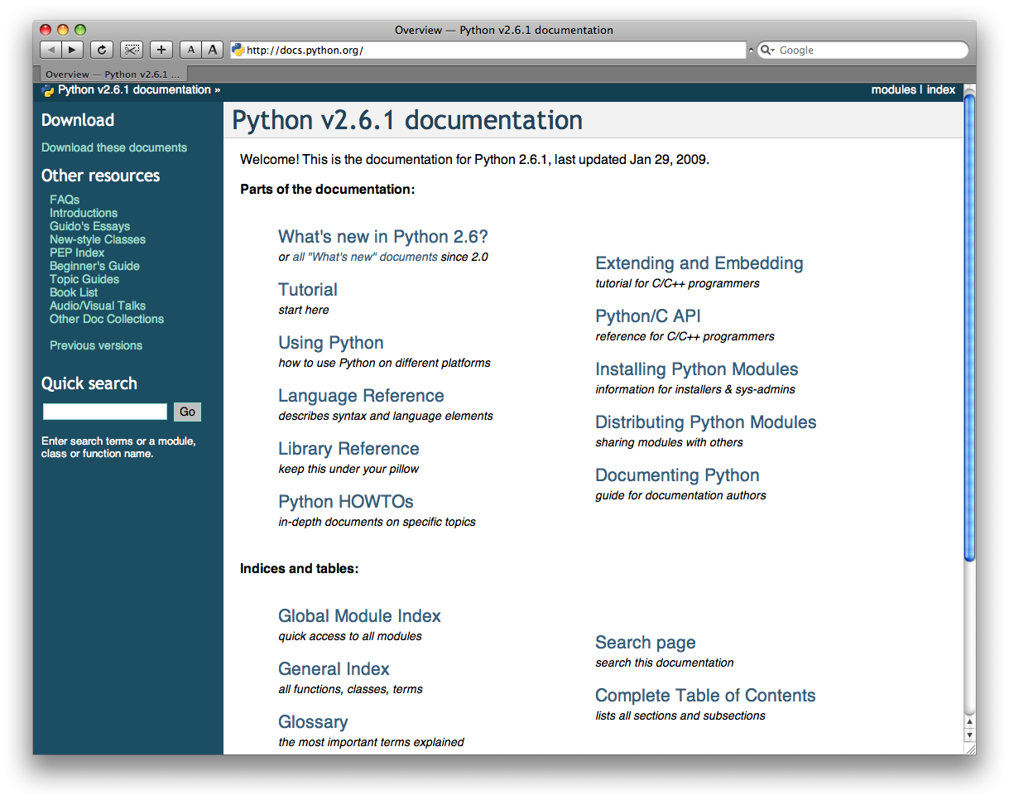
http://docs.python.org/

Slide 19
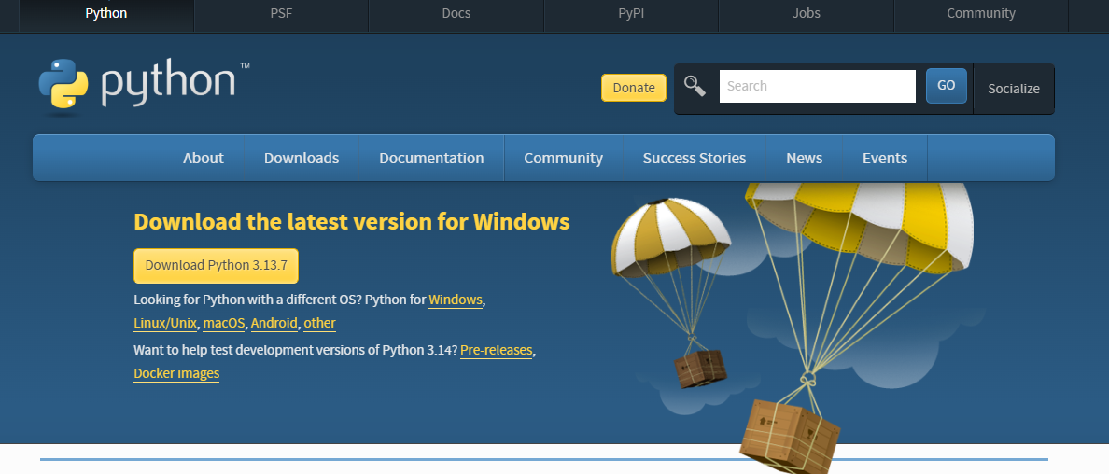
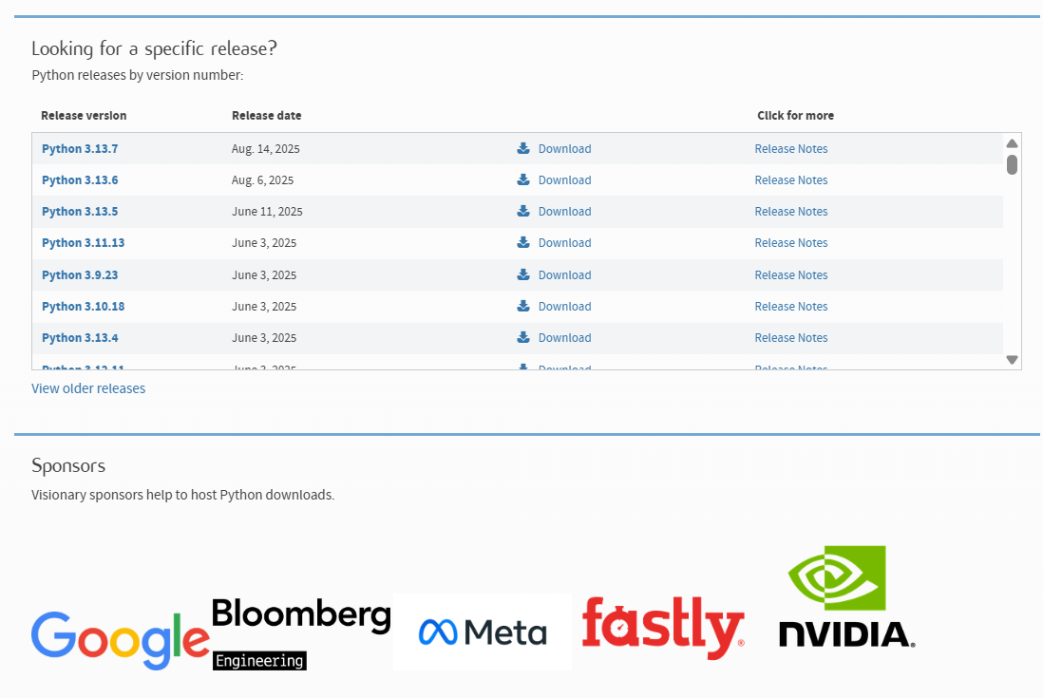
https://www.python.org/downloads/

Slide 20
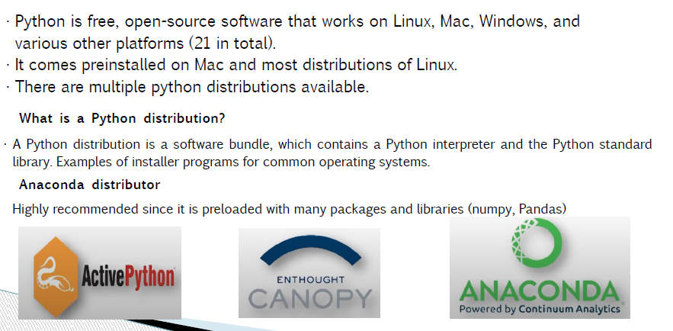
Working in Python

Slide 21
Python Environment
Unix (Solaris, Linux, FreeBSD, AIX, HP/UX, SunOS, IRIX etc.)
Win 9x/NT/2000
Macintosh (PPC, 68K)
OS/2
DOS (multiple versions)
PalmOS
Nokia mobile phones
Windows CE
Acorn/RISC OS
BeOS
Amiga
VMS/OpenVMS
QNX
VxWorks
Psion

Slide 22
Integrated development environment (IDE)
Software application consisting of a cohesive unit of tools required for development
Designed to simplify software development
Utilities provided by IDEs include tools for managing, compiling, deploying and debugging software

Slide 23
Features of IDE
IDE should centralize three key tools that form the crux of software development
  Source code editor
  Compiler/Interpreter
  Debugger
Additional features
  Syntax and error highlighting
  Code completion
  Version control

Slide 24
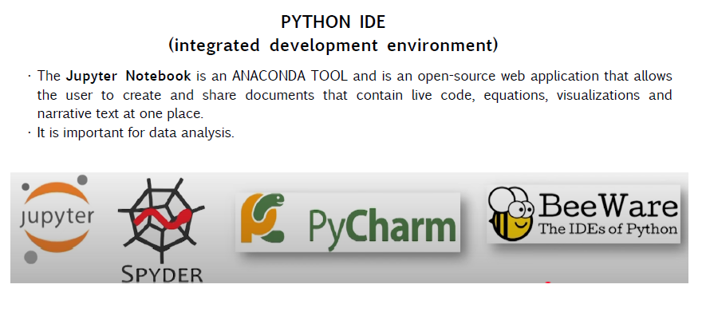
Python IDE

Slide 25
Libraries & Toolkits in Python
•A library is a collection of pre-combined codes that can be used iteratively to reduce the time required to code. (like ready mix masalas)
•There are over 137,000 python libraries present today, and they play a vital role in developing machine learning, data science, data visualization, image and data manipulation applications, and more

Slide 26
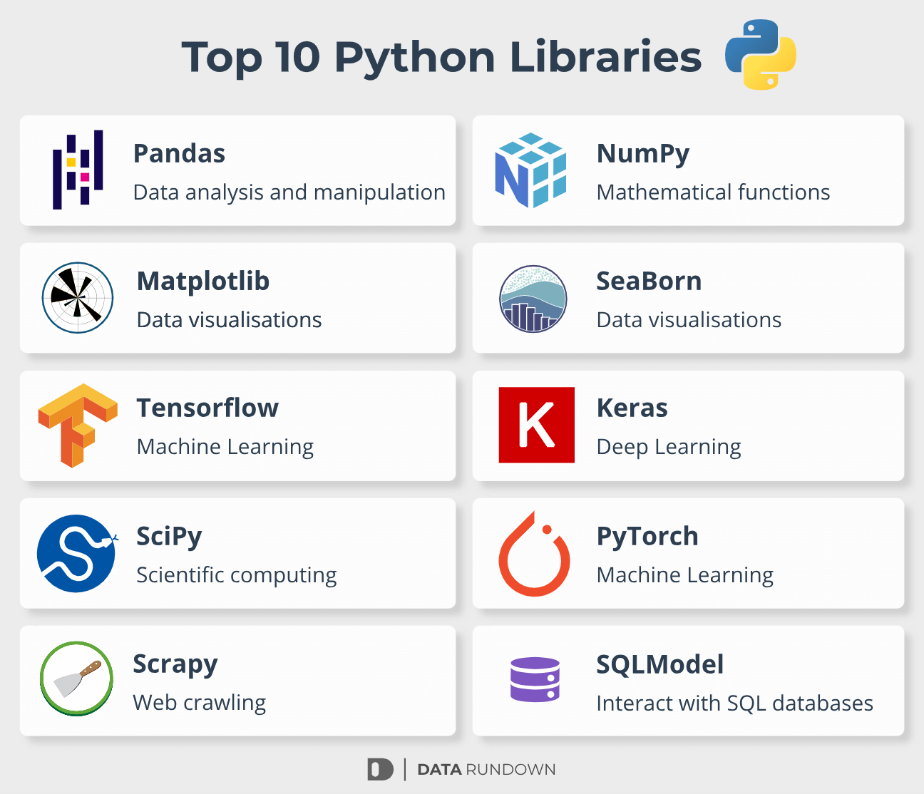
Libraries

Slide 27
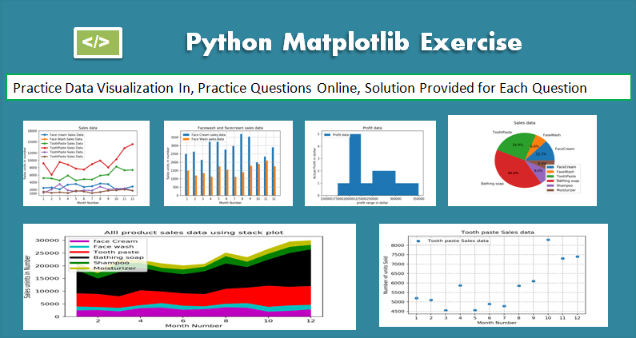
MatPlotLib
•Matplotlib is a comprehensive library for creating static, animated, and interactive visualizations in Python.
•Matplotlib makes easy things easy and hard things possible

Slide 28
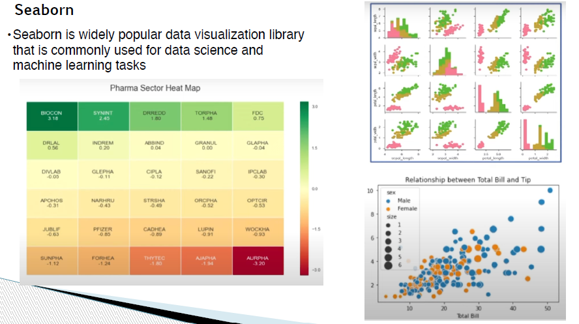

Slide 29
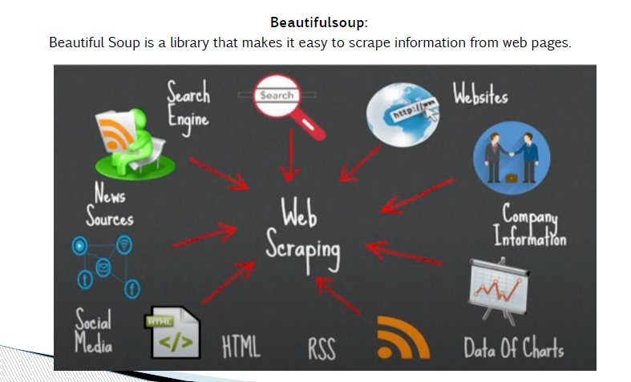

Slide 30
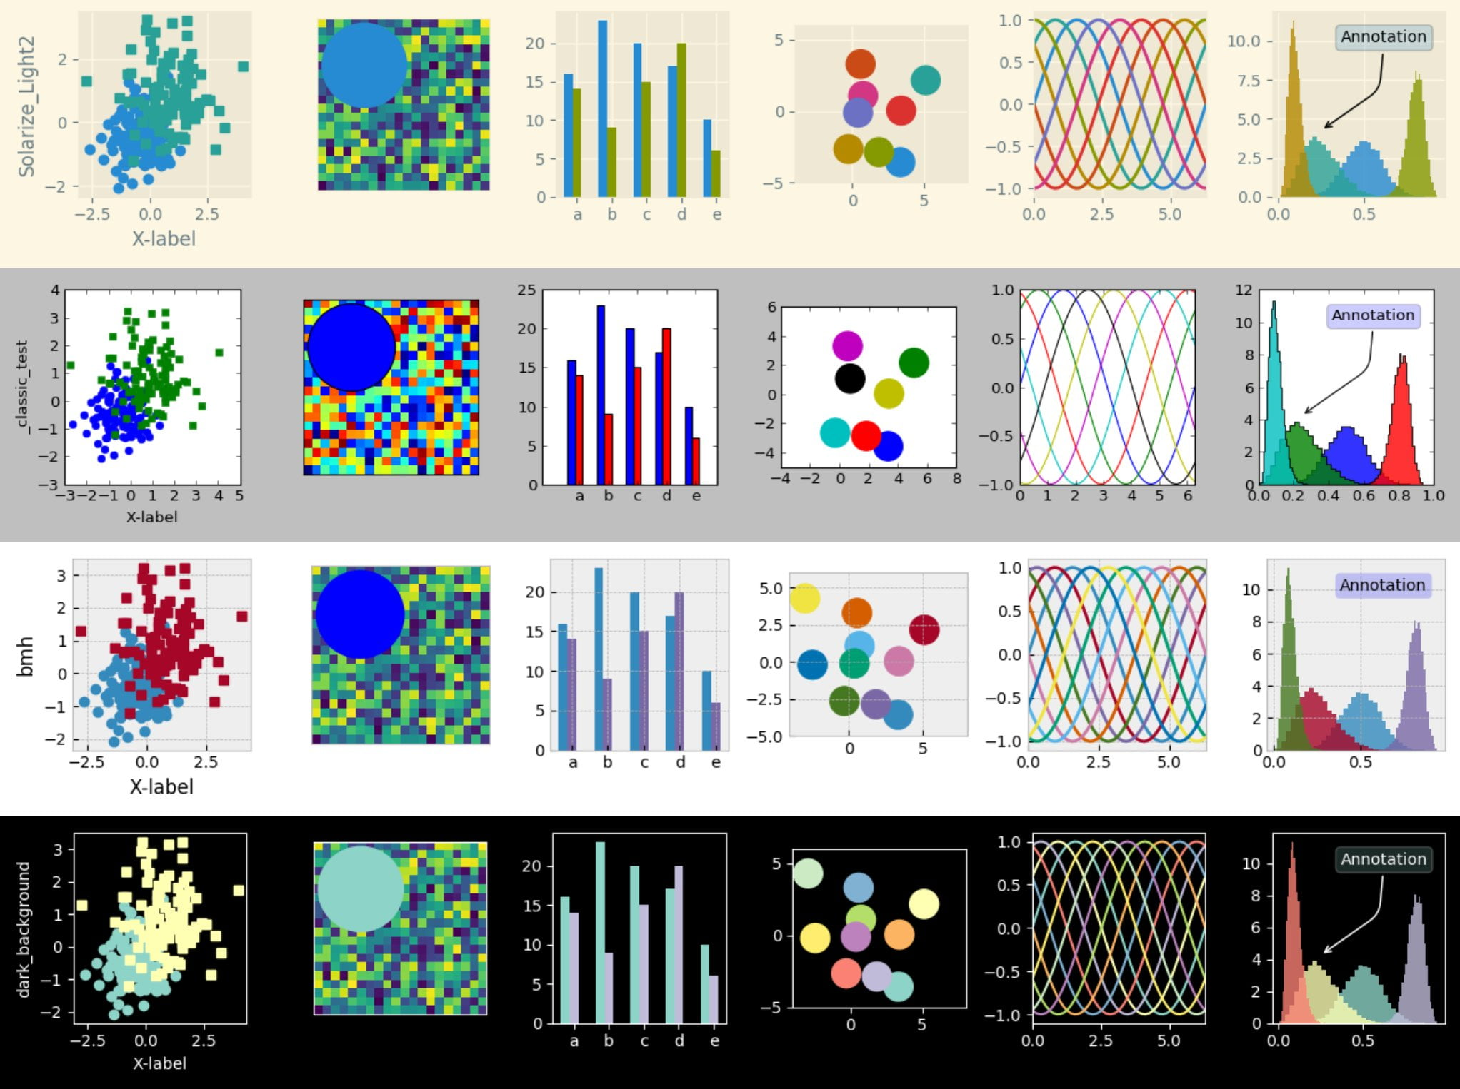
Visualization

Slide 31
Python Overview
Python is Interactive: This means that you can actually sit at a Python prompt and interact with the interpreter directly to write your programs.
Python is Beginner's Language: Python is a great language for the beginner programmers and supports the development of a wide range of applications, from simple text processing to WWW browsers to games.
Python is Object-Oriented: This means that Python supports Object-Oriented style or technique of programming that encapsulates code within objects.

Slide 32
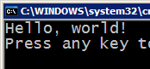

Python is Interpreted
Python is directly interpreted into machine instructions. The instructions are processed at runtime by the interpreter
interpret
source code
Hello.py
output

Slide 33
Python Features
Easy-to-learn: Python has relatively few keywords, simple structure, and a clearly defined syntax.
Easy-to-read: Python code is much more clearly defined and visible to the eyes.
Easy-to-maintain: Python's success is that its source code is fairly easy-to-maintain.
A broad standard library: One of Python's greatest strengths is the bulk of the library is very portable and cross-platform compatible on UNIX, Windows, and Macintosh.
Interactive Mode: Support for an interactive mode in which you can enter results from a terminal right to the language, allowing interactive testing and debugging of snippets of code.

Slide 34
Python Features (cont’d)
Portable: Python can run on a wide variety of hardware platforms and has the same interface on all platforms.
Databases: Python provides interfaces to all major commercial databases.
GUI Programming: Python supports GUI applications that can be created and ported to many system calls, libraries, and windows systems, such as Windows MFC, Macintosh, and the X Window system of Unix.

Slide 35
Python IDE

Slide 36
Commonly used Python IDEs
Spyder
PyCharm
Jupyter Notebook
Google Colab
Atom

Slide 37
Spyder
Supported across Linux, Mac OS X and Windows platforms
Available as open source version
Bundled with Anaconda distribution which comes with all Python libraries

Slide 38
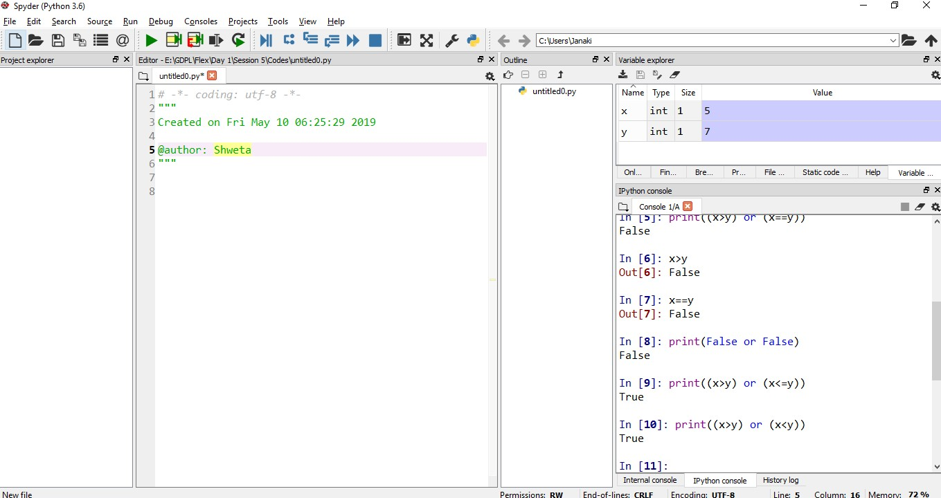
Spyder

Slide 39
Spyder
Features include
  Code editor with robust syntax and error highlighting
  Code completion and navigation
  Debugger
  Integrated document

Slide 40
PyCharm
Supported across Linux, Mac OS X and Windows platforms
Available as community (free open source) and professional (paid) version
Supports only Python
Bundled with Anaconda distribution which comes with all Python libraries
  Can also be installed separately

Slide 41
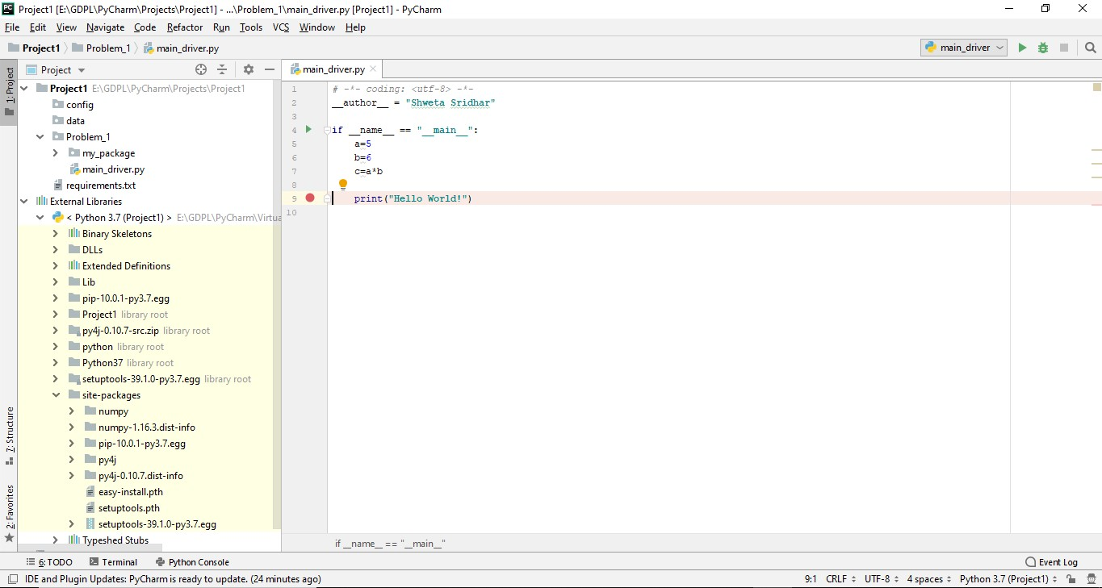
PyCharm

Slide 42
PyCharm
Features include
  Code editor provides syntax and error highlighting
  Code completion and navigation
  Unit testing
  Debugger
  Version control

Slide 43
Jupyter Notebook
Web application that allows creation and manipulation of notebook documents called ‘notebook’
Supported across Linux, Mac OS X and Windows platforms
Available as open source version

Slide 44
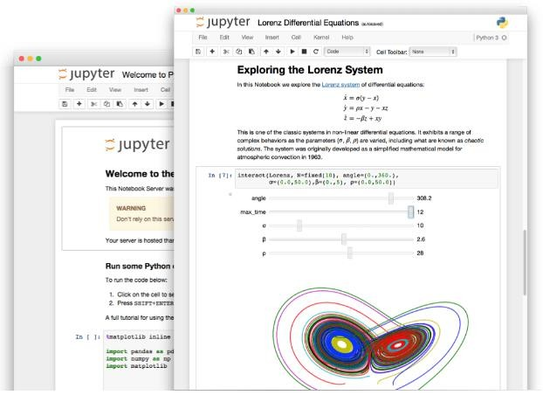
Jupyter Notebook
Source-https://jupyter.org/

Slide 45
Jupyter Notebook
Bundled with Anaconda distribution or can be installed separately
Supports Julia, Python, R and Scala
Consists of ordered collection of input and output cells that contain code, text, plots etc.
Source-https://jupyter.org/

Slide 46
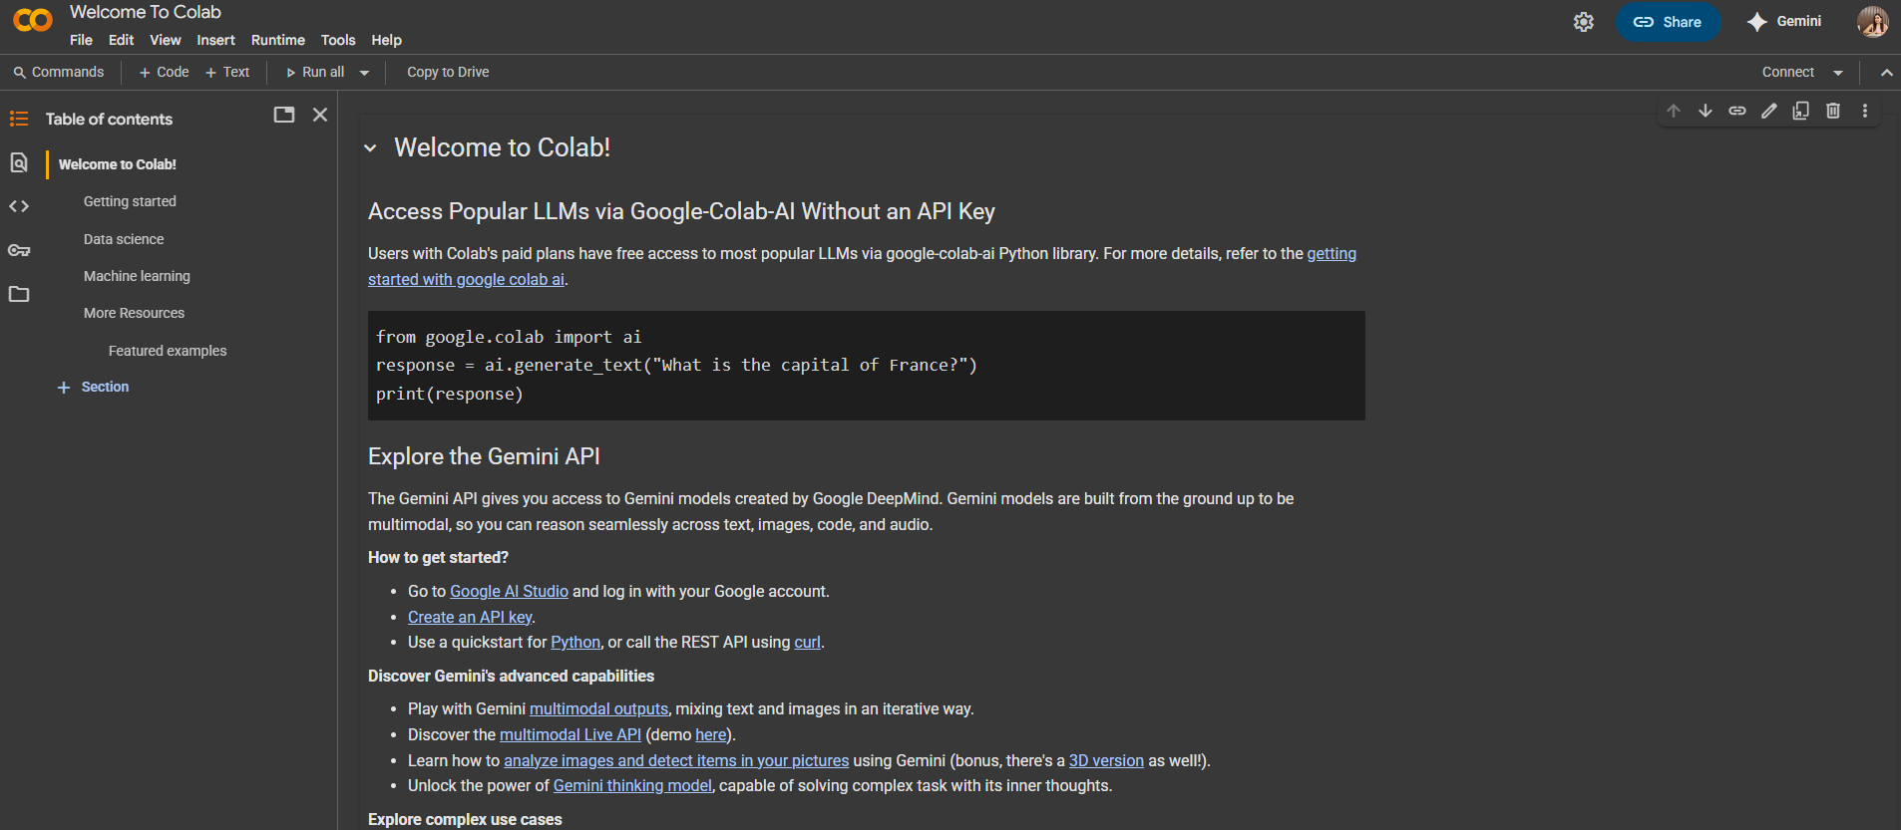
Google Colab- Online Jupyter Notebook

Slide 47
Atom
Open source text and source code editor
Supported across Linux, Mac OS X and Windows platforms
Supports Python, PHP, Java etc.
Well suited for developers
Enables users to install plug ins or packages
  Packages can be installed for code completion, debugging

Slide 48
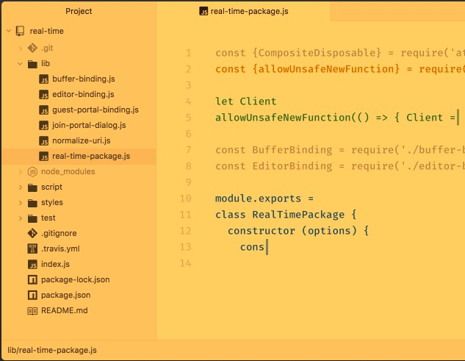
Atom
Source-https://atom.io/

Slide 49
How to choose the best IDE?
Requirements
Working with different IDEs helps us understand our own requirement
In this course, Spyder/Jupyter will be used

Slide 50

THANK YOU

